Slide 1
AVID 12
10.30.19

Slide 2
Philosophical Chairs pre work~ Should the death penalty be allowed?

Slide 3
You will draw (minus the pumpkins) and fill out the image in your AVID Interactive Notebook page 58

Slide 4
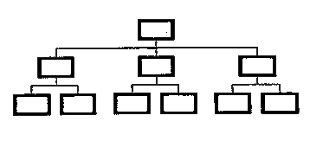
________________________________________________________________________________________________________________________________________________________________________________________
Describe what makes someone eligible for the death penalty
________________________________________________________________________________________________________________________________________________________________________
Title: Should the death penalty be allowed?
Give your stance in one sentence + draw an appropriate image
________________________________________________________________________________________________________________________________________________________________________
What are other options to the death penalty?
Explain what makes the death penalty so costly
_______________________________________________________________________________________________________________________________________________________________________________________
What makes the death penalty ethical?

Slide 5
Now that you have done your research, write a 5 sentence stance on page 57

